Slide 1
Arrays, Hashes, and Iteration
- Oh My!

Slide 2
Overview
Learning Ruby
Arrays
Basics
Built in Methods and Documentation
Hashes
Basics
Built in Methods and Documentation
Nested Data Structures
Iteration
Enumerables
Putting It All Together

Slide 3
Learning Ruby

Slide 4
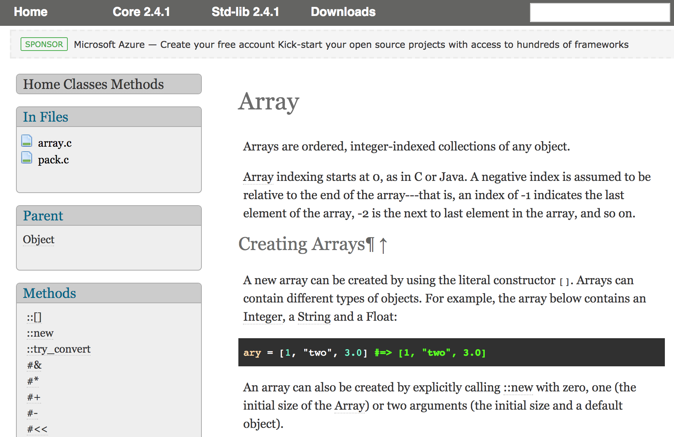
Ruby Version
Class Name
Class’ Parent
Class Methods (::)
Instance Methods (#)
Ruby Documentation - Classes

Slide 5
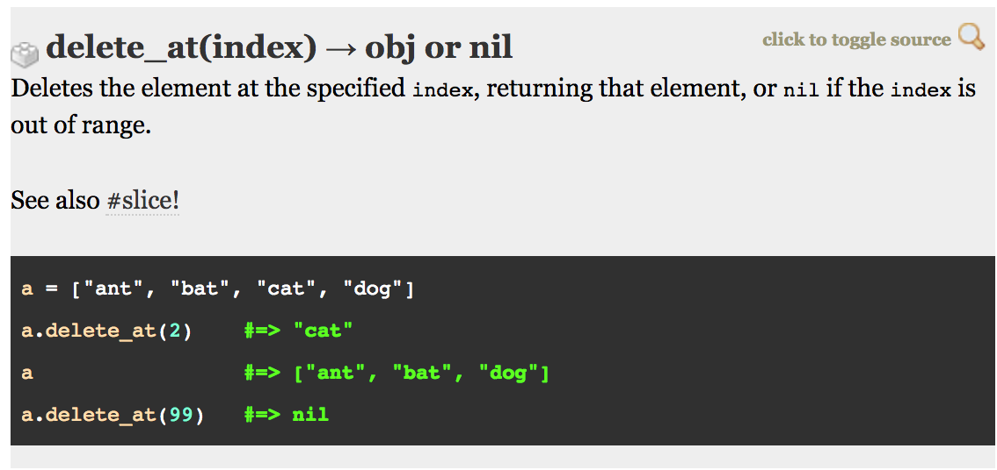
Parameter/Argument
Return Value(s)
Method Name
Explanation
Related Instance Methods
Examples
Ruby Documentation - Methods

Slide 6
IRB - “Interactive Ruby”

Slide 7
Arrays

Slide 8
Array Basics
An ordered, integer-indexed collection of objects
Indexing starts at 0
Negative indices are relative to the end of the array, for instance: an index of -1 is the last object in the collection, -2 is the second to last
0 1 2 3 4 5

Slide 9
Hashes

Slide 10
Hash Basics
A dictionary-like object containing key and value pairs
Keys are unique
Enumerate their objects in the order they were inserted
Key
Value
Key
Value

Slide 11
Instance/Built-In Methods

Slide 12
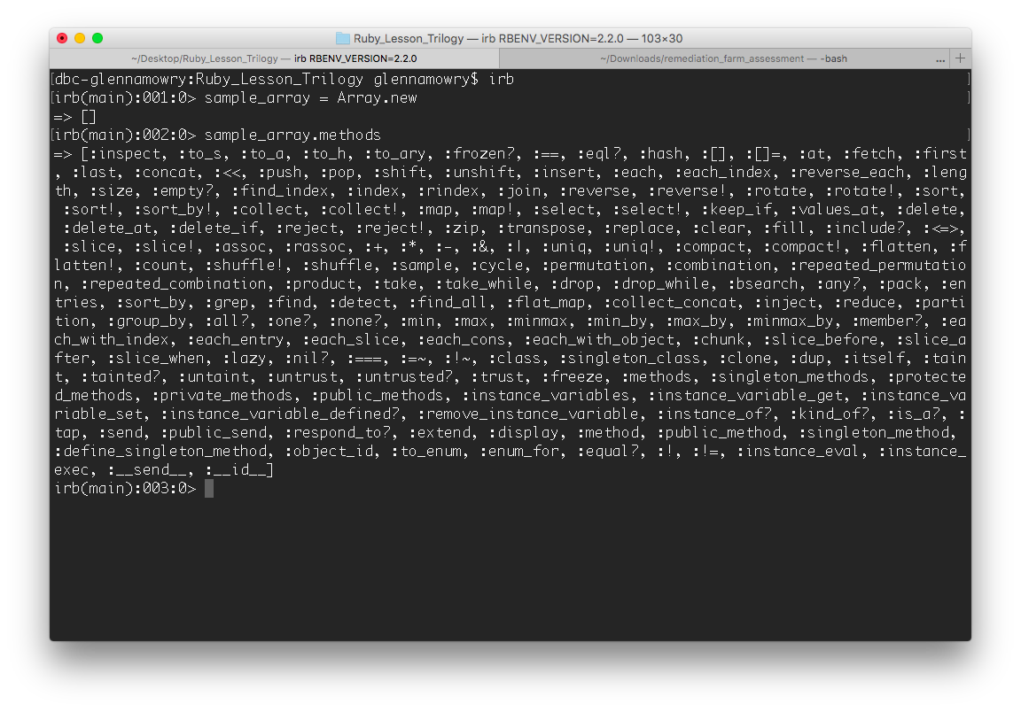
Array Methods

Slide 13
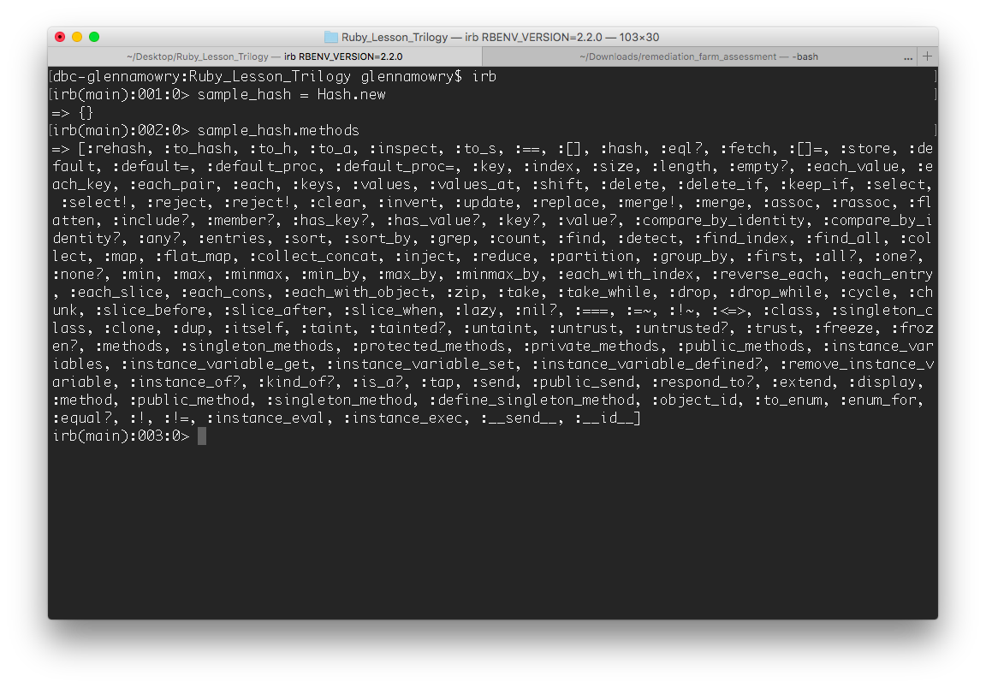
Hash Methods

Slide 14
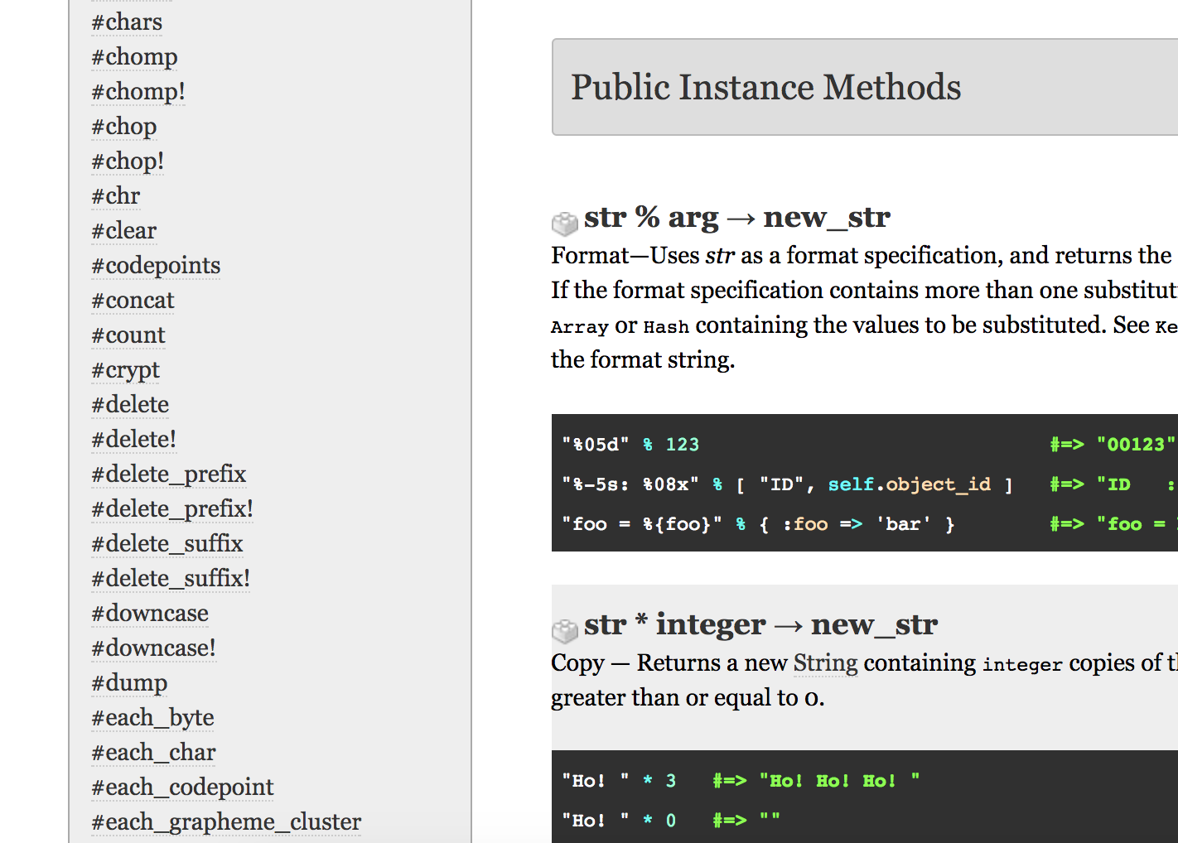
Instance Methods
Instance methods are those that are defined with the definition of the class itself in Ruby, like all methods for the Array Class or Hash Class
They are available to all instances of that object - so any Array you create, you can call one of the Array instance methods on it

Slide 15
Iteration

Slide 16
Iteration
To perform repeatedly
In the context of Ruby, we will repeatedly go through each item/key-value pair/object in a data type or structure
Can use different tactics but common ones are:
`for` loops
`each` Enumerable method
`times` Integer method with length of data type/structure

Slide 17
Nested Data Structures

Slide 18
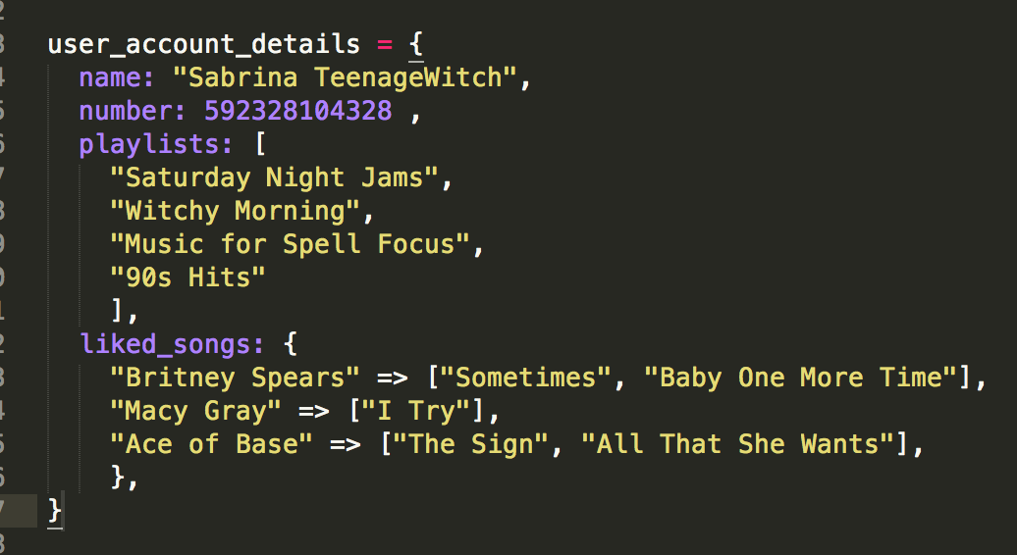
Nested Data Structure

Slide 19
Putting It All Together

